Slide 1
Lecture 4: system Calls Processes
Prof Yotov
CS6233
Slides developed by Prof. Sandoval
Some slides derived from: Prof. Dolan-Gavitt
Thanks!!!

Slide 2
System Call Interface
Once we are running a process in user mode that process must call into the kernel to
We do this using a system call
A system call is like a normal function call, but goes from low-privilege to high-privilege (user->kernel)
Notes:
How user programs talk to the kernel
Some of the things you do can only be done interacting with hardware
Access to hardware is a privileged operation
Is not something that most programs can do directly
Otherwise you would get into coordination problems if 2 things wanted to write to hardware at the same time
So instead we say that the kernel is the only thing allowed to access hardware
But now that means that we need to have some interface for programs to do that.
We do that with system calls.
Basically a controlled way to switch into kernel mode.
From the users perspective it looks like a function call
But what it’s doing is jumping into kernel mode and then carrying out some functions there.
We are going to see in explicit detail how this works.

Slide 3

Making a System Call
Notes:
You can imagine how the programs exist above and kernel below
Key point:
1 kernel
Multiple programs
Red line: privilege.
Kernel has access to hardware
Question:
Does the kernel need to be written in assembly? NO
Only the part that directly manipulates the CPU

Slide 4
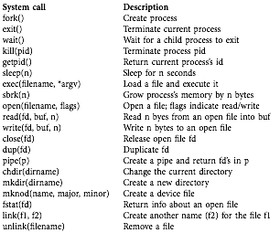
Notes:
We’ve seen this list before
The ones on the top deal with processes we’ll look at them later.
But you have various functions that deal with I/O that you dealt with in HW 1.
We’ve got things that deal with pipes that you have used, but not done any implementation on.
Then you got some that might look slightly weird like mknod

Slide 5
mknod(name,major,minor)
We already discussed the "everything's a file" concept
So, we know that some files can refer to things other than bytes on a filesystem
mknod allows you to create such pseudo-files
The major and minor numbers tell the kernel how to interpret reads/writes to the file
Notes:
We arleady discussed that in Unix everythnig is a file.
This gets to the idea in unix that everything is a file
You can do man mknod.
This call allowes you make files on disk that represent hardware devices.
The way you know which device it is, is by passing this major and minor numbers to the kernel
It tells it which device driver to use.
For example it might be a specific kind of of serial port.
This call is specific to unix like operating systems
Windows doesn’t have

Slide 6
Example device
Major
Minor
crw-rw-rw- 1 root wheel 3, 3 Sep 7 12:12 /dev/zero
mknod("/dev/zero", 3, 3)
Notes:
We could use any kinds of devices but this is one that exist in OS X.
When your read from it, it produces an infinite stream of null bytes.
This might not seem very usefule but imagine if you want to wipe a harddrive.
You might be able to copy all the bytes from /dev/zero on to the hard drive and completely wipe out that drive.
The way this is implemented is on the kernel looks at a table that has been created called dev/zero
Another usefule device is the nulldevice.
For example a program might create output you don’t want to see.
This is again going to be another of these devices with its major and minor number.

Slide 7
link(file1,file2)
Creates another name for file1
Similar to how two file descriptors can refer to a single file
Multiple names for a single file are persistent and implemented at the filesystem level
Notes:
This helps link files
It basically just creates names for another file
You can have two files in your hard drive that refer to the same data.
This is usefule for some reasons, like not moving the file around if a program expects it.
Header libs.

Slide 8
inodes
On the filesystem, each file is identified by a unique number (an inode number)
The link system call just creates another name in the filesystem with the same inode
You can see these numbers with "ls –I”
Notes:
This can be used with things that are called file system debuggers
Which can help you bring back deleted files using the inode

Slide 9
Real-World System Calls
Linux is a UNIX-like operating system, so the concepts are similar
But it has many more calls – 389 as of kernel version 3.19
Interface is public – user programs can use it directly
Many more than xv6!
Notes:
XV6 is a tiny operating system
They fit in a slide!
Real OS support way more functionality
Threads
Networking
Since it’s public programs depend on it.
So you can’t remove system calls.
You might have something like seek(fd, move) then seek2 which adds more option
You can’t remove seek because you would break programs.

Slide 10
Real-World System Calls
Windows has even more – 1,468 as of Windows 8
The majority of these (1,036) are GUI-related
The system call interface is private
All calls go through a (much larger) set of user-space libraries that are stable (the Win32 API)
Notes:
1K of them are for doing things graphically
Creating menus, buttons, etc.
They put all the graphical stuff in the kernel
So programs that want to draw on screen need to call on the kernel
Unix systems are taking advantage that everything is a file
A lot of systems calls that windows has are just operations on files for unix.
One interesting thing about windows is that system calls are not documented.
Then how do they do it?
Everything goes through the Win32 API.
They provide you with a bunch of standard APIs that use the system calls.
So windows can change the system calls as long as this set of APIs stays stable.

Slide 11
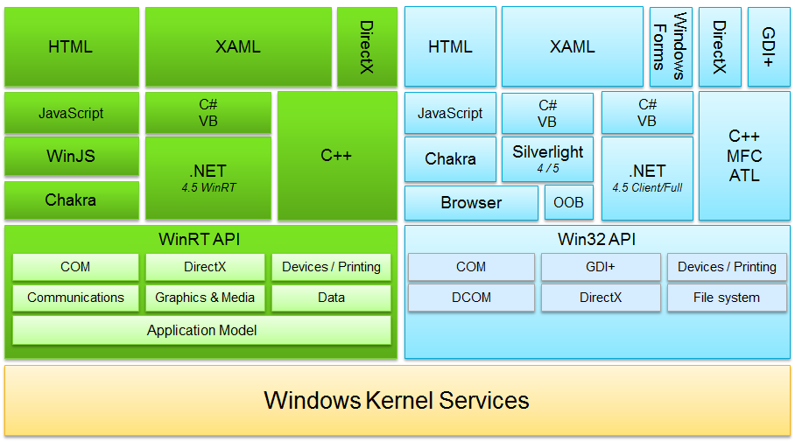
Notes:
This sometimes gets complicated as you can see here.
This is the set of APIs that MS exposes.
Here you have the kernel but you have like a whole bunch of APIs like Win32, WinRT

Slide 12
System Call Mechanism
To implement a system call, we need to do several things:
Have an instruction that initiates the call
Specify which call we want
Have the kernel retrieve the system call arguments
Save the process's current state and restore it when we return
Do all this securely, without breaking isolation between user and kernel space
Notes:
We need to have an X86 assembly instruction.
The mechanisms that keep kernel space and user space separate are done in hardware.
At the end of the day it’s all just running on the CPU, to get this level of protection.
Save the process state because we want to make it look like a function call
When we go into the kernel and come back we have to guarantee that nothing will change.
So we have to save the entire CPU and restore.
We also need to do this securely.

Slide 13
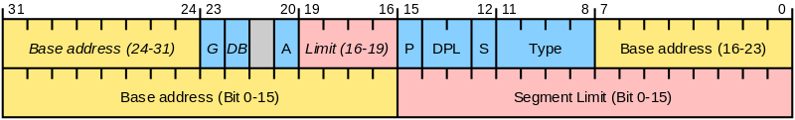
Reminder: Segment Descriptors
DPL – privilege level of the segment
Notes:
WE skimmed over this and we won’t dwell too much over it,
But x86 has segments to tell it how to treat certain parts of memory.
One of the things they include is the privilege level of the segment.
Most programs run on priviliege level 3, which is also called ring 3.
The idea here that you are supposed to think that you have concentric centers or rings
Ring 0 is where the kernel runs,
Ring 1 and 2 exists but noone uses them.
What privilege level you are at determines what instructions you can run

Slide 14
The Interrupt Descriptor Table
System calls, interrupts and exceptions are handled using the same mechanism
Each one is handled by the processor by consulting the interrupt descriptor table
The interrupt descriptor table contains 8-byte entries that describe what to do for each interrupt number
Notes:
This means you only need to write one exception handler.
When an interrupt or exception happens you look at this descriptors and each one describes what to do for each descriptor.

Slide 15
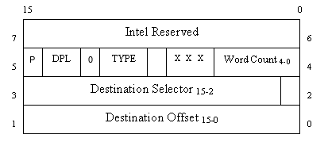
Interrupt Descriptor
SETGATE(idt[T_SYSCALL], 1, SEG_KCODE<<3, syscall_handler, DPL_USER);
(gate).off_15_0 = syscall_handler & 0xffff;
(gate).cs = SEG_KCODE << 3;
(gate).args = 0;
(gate).rsv1 = 0;
(gate).type = STS_TG32;
(gate).s = 0;
(gate).dpl = DPL_USER;
(gate).p = 1;
gate).off_31_16 = syscall_handler >> 16;
Notes:
What do they actually contain?
The address of some code to execute in the kernel
You might want to use a different stack. So it might contain a new code segment.
System calls are implemented using software interrupts.

Slide 16
The int Instruction
"int n" does a lot of work
Fetch the nth descriptor from the IDT, where n is the argument of int.
Check that CPL in %cs is <= DPL, where DPL is the privilege level in the descriptor.
Save %esp and %ss in a CPU-internal registers, but only if the target segment selector’s PL < CPL.
Load %ss and %esp from a task segment descriptor.
Notes:
Transferring from user mode to kernel mode in a secure way requires a lot of work.
First we fetch the descriptor from the Interrupt descriptor table.
Check that the current privilege level is less than or equal to the one in the descriptor table.
We need to transfer to kernel mode in a way that makes it look like just a function call, so we need to save a lot of state.
We are gonna switch stack so we need to save the stack
And then we load a new stack from the descriptor table.

Slide 17
The int Instruction
Push %ss.
Push %esp.
Push %eflags.
Push %cs.
Push %eip.
Clear some bits of %eflags.
Set %cs and %eip to the values in the descriptor.
Notes:
But that’s not all:
So now we have to save the user’s context.
Remember that the user program expects that everything will be back the same way it was before it went into a kernel call.
So we need to push a bunch of stuff into the stack:
Condition flags
Current code segment
Current program counter
Then we clear some flags so that they are in a known state.
Eflags also contains some bits to know how the processor operates.
Flags for copy string.
Then finally we change the segment that represent running code the CS segment and we change the program counter to the value specified in that descriptor.

Slide 18
Why So Complicated?
Mostly to ensure protection
CPL check prohibits anything but a user process from making any other interrupts
Kernel reads some information off the stack; arbitrary user stacks might be incorrect (point to nonexistent memory) or malicious
Notes:
CPL ensures that the only thing that can call from user program are the ones we are authorized to.
If we could call any of them, we could cause say interrupt 5 for the disk.
We need to ensure that programs only can use certain interrupt numbers.

Slide 19
initcode.S
Last time we saw the system's first system call
# exec(init, argv)
.globl start
start:
pushl $argv
pushl $init
pushl $0 // where caller pc would be
movl $SYS_exec, %eax
int $T_SYSCALL
[...]
# char init[] = "/init\0";
init:
.string "/init\0"
Notes:
Let’s figure out where we are:
The kernel is now running.
It’s setup all the hardware and it’s gonna transition to user mode and run this tiny snippet of code.
This will be the first user process.
This program will setup the arguments to the system call by pushing the arguments onto the stack.
Then it indicates which system call it wants.
The convention:
Is to put the system call number in EAX
And then you execute your software interrupt
Here we are gonna call the exec system call which creates a program
At this point it transitions into the kernel.
Loads the code for the init program.
What exec does is replaces the current program with the one you specify.
We replace the first user process with the one that is in init.c.

Slide 20
Trap Frames
Once we are in the kernel, we save more registers (alltraps, trapasm.S)
Together with the registers the CPU saved for us, this makes up a trap frame
alltraps:
# Build trap frame.
pushl %ds
pushl %es
pushl %fs
pushl %gs
pushal
Pushes all general-purpose registers onto the stack
Notes:
The interrupt saved some things for us, but it didn’t save everything.
So we are gonna push a few more things we wanna save about the user program.
save all these other registers eax, ebx, ecx, esi edi and so on

Slide 21
Trap Frame
// Layout of the trap frame built on the stack by the
// hardware and by trapasm.S, and passed to trap().
struct trapframe {
// registers as pushed by pusha
uint edi;
uint esi;
uint ebp;
uint oesp; // useless & ignored
uint ebx;
uint edx;
uint ecx;
uint eax;
// rest of trap frame
ushort gs;
ushort padding1;
ushort fs;
ushort padding2;
ushort es;
ushort padding3;
ushort ds;
ushort padding4;
uint trapno;
...
Notes:
So now we can define a data structure called a trap frame which as long as we have pushed the registers in the right order.
We can interpret the stack as an instance of that struct.
This is like taking a ptr to this data structure.
You have the things pushed by interrupt
The stuff we pushed
That gave us what call we need.

Slide 22
Trap Frame
By capturing all of this information in the trap frame structure, we can restore the CPU state exactly when we return from the system call

Slide 23
Trap Handler
After we've set up our trap frame, we call the trap() function:
# Call trap(tf), where tf=%esp
pushl %esp
call trap
addl $4, %esp
Notes:
We are gonna go into the C code that handles the trap function

Slide 24
Trap Handler – trap.c
void
trap(struct trapframe *tf)
{
if(tf->trapno == T_SYSCALL){
if(proc->killed)
exit();
proc->tf = tf;
syscall();
if(proc->killed)
exit();
return;
}
switch(tf->trapno){
case T_IRQ0 + IRQ_TIMER:
if(cpu->id == 0){
acquire(&tickslock);
ticks++;
[...]
Notes:
Remember how over here, we “know” how the stack is. So we can cast it to a trapframe type.
The function It’s gonna check if the interrupt number corresponds to the one we designated for system calls,
In our case it’s 64
Then ti’s just gonna call the syscall function after setting the trap frame to the trap frame that was passed in.

Slide 25
Inside the System Call
After setting up the trap frame, we call the syscall() function
syscall() examines %eax in the trap frame to find out what system call to execute
Inside the system call, things look exactly the same as a normal function call
But we have extra privileges since we are in kernel mode; e.g. we can talk to hardware directly
Notes:
So now we are finally at the point where we can decide which system call we wanna execute,
How we can get the arguments and what we should do.
Syscall looks as eax in the trap frame
We have switched to kernel mode.
The CPU context is completely different.
None of the registers from user space exist anymore except on the data structure where we saved them.
So if we want to know what the value of eax was before, we need to look at the one we saved on the data structure.
We are gonna use what’s in EAX to index into an array and execute whatever is there.
The only thing is that we have extra privileges. We are the kernel, we can do everything we like read any memory we like
Talk to the hardware directly. We have full control over the machine.

Slide 26
kill(pid)
void
syscall(void)
{
int num;
num = proc->tf->eax;
if(num > 0 && num < NELEM(syscalls) && syscalls[num]) {
proc->tf->eax = syscalls[num]();
} else {
cprintf("%d %s: unknown sys call %d\n",
proc->pid, proc->name, num);
proc->tf->eax = -1;
}
}
int
sys_kill(void)
{
int pid;
if(argint(0, &pid) < 0)
return -1;
return kill(pid);
}
Notes:
Here we can see the syscall function:
As you can see besides just checking that it’s in a valid range (greater than zero and less than what we have,
If it’s valid we just call the appropriate syscall using a function pointer.
Then we get back the result and store it in eax.
As an example below we have the sys_kill function

Slide 27
Retrieving Arguments
We changed stacks after leaving user mode
But arguments are still stored on the user stack!
Solution: use the %esp value saved in the trap frame
Arguments are at %esp+4+(4*arg_no)

Slide 28
Retrieving Arguments
// Fetch the nth 32-bit system call argument.
int
argint(int n, int *ip)
{
return fetchint(proc->tf->esp + 4 + 4*n, ip);
}
int
fetchint(uint addr, int *ip)
{
if(addr >= proc->sz || addr+4 > proc->sz)
return -1;
*ip = *(int*)(addr);
return 0;
}
Notes:
So this is how we do this In practice.
There is the argint argument function.
Which fetches the nth argument from the data structure where we stored it.
It’s adding 4 because when the user executed the call it put the return address on the stack
Rememeber the prologue ?
And then we are indexing into the nth argument.
Each argument is 32 bits so each one is 4 bytes.
Now if we look at fetchint we see how we have to be very careful when writing operating systems.
Because we want to make sure that the address that we are being passed is in our address space.

Slide 29
Protection
Note the check in fetchint to make sure the pointer is not outside proc->sz
In user mode, we can rely on the paging hardware to disallow access to anything outside of process's memory
But in kernel-mode we must do explicit checks, because the kernel has access to all memory
Similar checks for getting a pointer (argptr) and getting a string (argstr)

Slide 30
Returning to Userspace
syscall() put the return value in proc->tf->eax
So when we get back to userspace, we will have our return value in %eax
.globl trapret
trapret:
popal
popl %gs
popl %fs
popl %es
popl %ds
addl $0x8, %esp # trapno and errcode
iret
Notes:
If you remember a few slides back we stored the return value in EAX (slide 27).
So when we get back from the syscall we will get the value in EAX.
Here we go back to userspace with a little snippet of assembly code.
Here’s what we do, similar to
Pushal we have popal which pops our registers.
Then we pop by hand the segment registers we had pushed
There were a couple of things that were put in the stack by hardware, so we get past them
And then finally the corresponding thing to an int instruction is an iret
Or return from interrupt, this sets the CPU back to unpriviliged mode and the place
Where you made the interrupt call

Slide 31
Adding a System Call
From this, it should be easy now to add a system call
We don't have to alter the mechanism, just extend the list and implement our function
Notes:
We can add priviliged operations
In HW 3 we will implement a process scheduler.
This will be a priviliged operation

Slide 32
Hello World
We will add a system call that just prints hello world an a user-provided number
First we need to add our call to the list in syscall.c
extern int sys_write(void);
extern int sys_uptime(void);
extern int sys_hello(void);
static int (*syscalls[])(void) = {
[SYS_fork] sys_fork,
[SYS_exit] sys_exit,
[SYS_wait] sys_wait,
...
[SYS_link] sys_link,
[SYS_mkdir] sys_mkdir,
[SYS_close] sys_close,
[SYS_hello] sys_hello,
};
Notes:
This is the array that has all the system calls.
This syntax is just a way to define an array, so you can put the array index and then the value
SYS_EXIT is gonna be a number,
Sys_exit is gonna be the address of the function

Slide 33
Hello World
Next, assign it a number in syscall.h:
And give it a prototype in user.h:
#define SYS_mkdir 20
#define SYS_close 21
#define SYS_hello 22
int dup(int);
int getpid(void);
char* sbrk(int);
int sleep(int);
int uptime(void);
int hello(int);
Notes:
Where are these numbers defined?
They are defined in a file so we can just pick an unused number.

Slide 34
usys.S
Add it to usys.S, which generates the user-space assembly code for it
#define SYSCALL(name) \
.globl name; \
name: \
movl $SYS_ ## name, %eax; \
int $T_SYSCALL; \
ret
SYSCALL(fork)
SYSCALL(exit)
...
SYSCALL(uptime)
SYSCALL(hello)
Notes:
The last piece:
When we do a system call, if you think about it, the code that needs to put the correct interrupt into EAX and then
Make the ret call
This is just defining a preprocessor macro.
A slight fancy cut/paster
This macro is basically creating a label
Then moving the interrupt number into EAX
Then executes the interrupt.
On the OS side we need to have some code that back that interrupt, the new system call we are adding.

Slide 35
Implementation
Finally we add the implementation somewhere (e.g. sysproc.c)
int
sys_hello(void) {
int n;
if(argint(0, &n) < 0)
return -1;
cprintf("Hello world %d\n", n);
return 0;
}
Notes:
Again this is gonna look a lot like the
Check that we are not fed a bad value.
Cprintf Looks diffreent because you don’t need to have access to the file descriptors

Slide 36
Testing Our New Call
#include "types.h"
#include "stat.h"
#include "user.h"
int main(void) {
hello(5);
exit();
}
Notes:
How do we call this?
We can create a new program that calls hello and then exits.

Slide 37
Real-World: A Newer Mechanism
Older versions of Linux and Windows did use interrupts for system calls
Nowadays most systems don't use them
Interrupts are very heavyweight, slow
Instead we have sysenter and sysexit
These do much less work – mostly just switches to kernel mode, sets CS, ESP, and EIP
Up to the kernel to decide how much it wants to save from user mode
Notes:
Back into the early 2000s.
To make a system call you where doing more than it was needed.
Intel happy to oblige
They introduces sysenter/sysexit
The older sytem still works and is supported it’s just a little bit slower.

Slide 38
processes

Slide 39
Processes
A process is the basic unit of execution and an abstraction for a running program
Splitting up the execution of a system into processes allows:
Isolation between programs
The ability to simulate running multiple programs at once with only one CPU
Notes:
Switch every 10ms so that it look like things are running simyltaneously

Slide 40
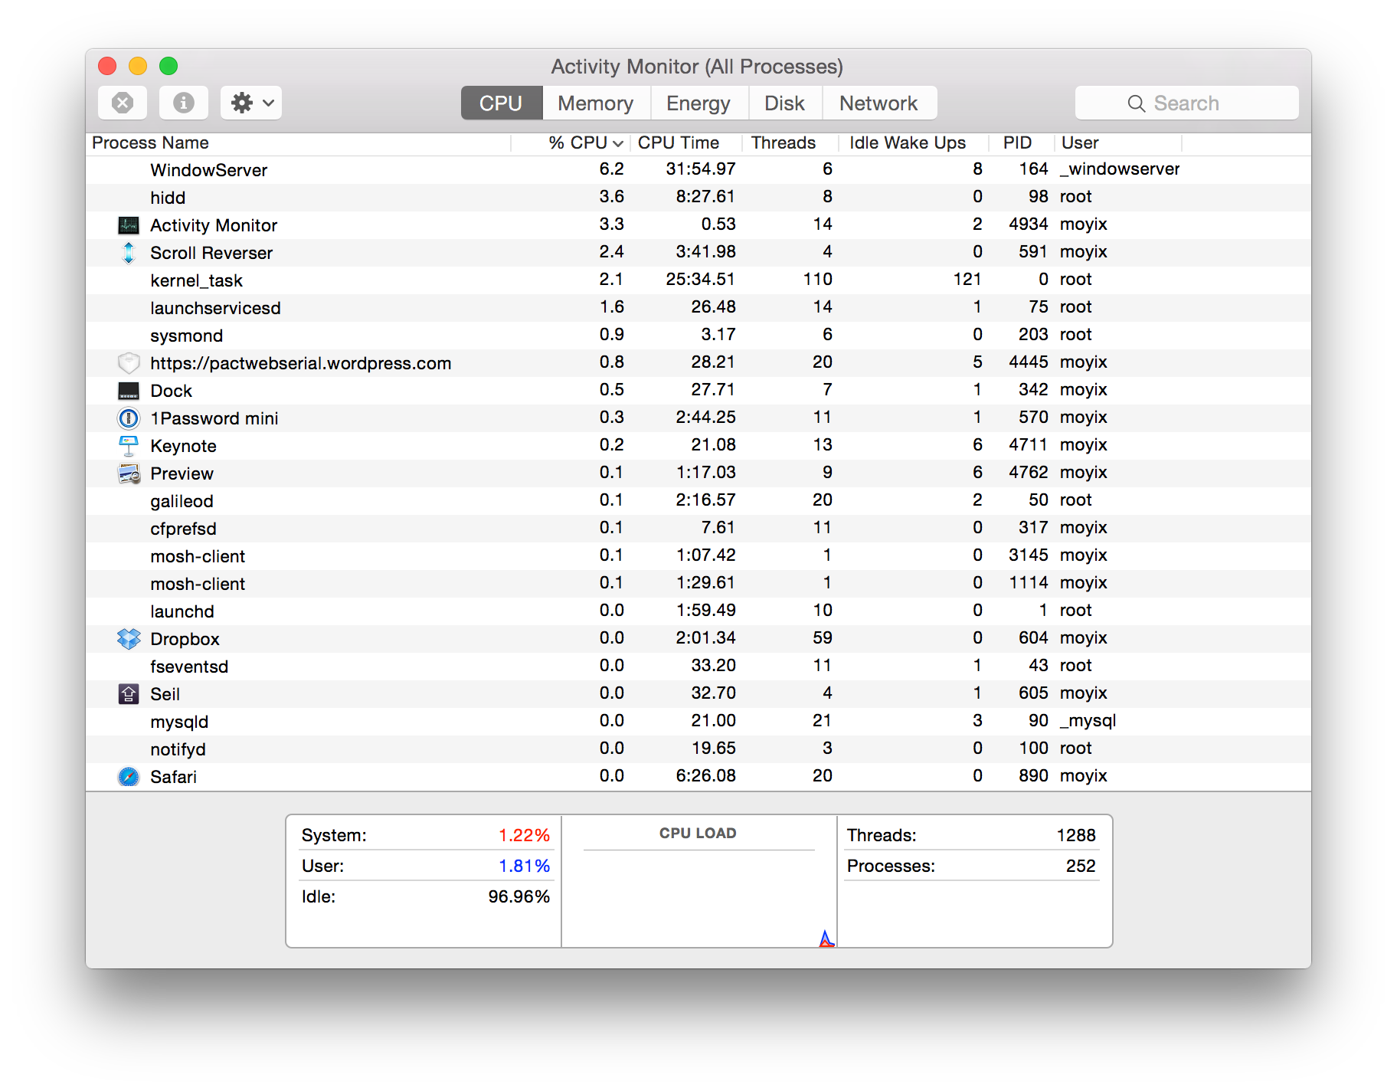
Lots of Processes
Notes:
Each process has a bunch of threads
You can see them here

Slide 41
Processes in Parallel
It is confusing to reason about many events happening at once
The process model lets us consider each process as a single, sequential execution
(For now, we'll consider just one CPU)

Slide 42


One CPU, Many Processes
Process A
CPU
Saved CPU State
Process B
Saved CPU State
Process A
Saved CPU State
Process C
Saved CPU State
Notes:
Saved state is a copy of the registers
We switch really quickly in succession
When we switch we need to save the CPU state.
One thing you can do is give more share of the CPU by giving it more priority.

Slide 43
Abstraction
Multiple Program Counters
Process A
Process B
Process C
Notes:
It makes it look like you have multiple process running at the same time

Slide 44
Plotting Process Execution
C
B
A
Notes:
If you were going to plot this where the X axis is time
At no point we have more than one thing running at a time.

Slide 45
Processes Are Not Programs
A program is a collection of executable code and data
A process is the OS abstraction for a running program, its resources, input/output, etc.
So: multiple copies of a program can be running in different processes
Notes:
Not only the program but also it’s resources.
The code for a program can exist in two different programs

Slide 46
Process Creation
Processes can be created in many circumstances
At boot time
User request (e.g., typing a command)
A running program creates a new process on its own
All of these are actually carried out by execution of a system call (with the exception of the first process, which is created directly by the kernel)

Slide 47
Killing Processes
Processes can exit on their own using a system call
One process can request that the OS terminate (kill) another process
Depending on the privilege of the requestor, this may or may not be granted
Notes:
We looked at the kill system call

Slide 48
Killing Processes
In most operating systems, process termination notifies the process to be terminated first so it can cleanly free resources
More forceful methods exist:
kill -9
taskkill /f
In all cases, the operating system will free the resources that it has granted to the process
Notes:
In unix it sends a message saying turn yourself off
Depending on the state it might answer that message or not. It might be hung
At that point you can bring out the big guns:
Use -9 for kill – just force
Buff[1024]
While(read(buff, 64)
{
cmputation
}
Write.
If you kill in the middle of the computation.
The OS doesn’t know. There are strong theoretical results that this will never work.
If you can bring down a process cleanly. If not bring out sigkill
Java example:
- Java was buffering.

Slide 49
Process Hierarchy (UNIX)
In UNIX, each process (aside from init) has a parent process that created it
This relationship creates a tree structure, rooted at the init process
Processes are often managed as a group consisting of a single process and all its descendants
E.g., signals (such as SIGTERM, to request termination) are delivered to parent and all its descendants
Notes:
Don’t take the human metaphor too far.

Slide 50
Process Tree
systemd─┬─ModemManager─┬─{gdbus}
│ └─{gmain}
├─acpid
├─agetty
├─cron
├─dbus-daemon
├─dhclient
├─fail2ban-server───2*[{fail2ban-server}]
├─master─┬─pickup
│ └─qmgr
├─mosh-server───bash───tmux
├─9*[mosh-server───bash]
├─ntpd
├─polkitd─┬─{gdbus}
│ └─{gmain}
Notes:
It used to be called init and now it’s systemd

Slide 51
Hierarchy and Termination (UNIX)
If the parent process exits before its children, those children are said to be orphaned
Orphaned child processes are adopted by init

Slide 52
Zombies (UNIX)
Zombies are processes that have exited but still have an entry in the process table
If a child process exits and the parent has not called wait() to get its exit status, the child becomes a zombie
This is because the exit status is stored by the kernel-side data structure, and the kernel can't free it until it knows no one needs the exit status
Notes:
Another fundamental unit of the family
Have exited but the OS is keeping track of it on some way.

Slide 53
#include <stdlib.h>
#include <unistd.h>
#include <stdbool.h>
int main() {
if (fork() == 0) {
// Exit immediately in the child
exit(1);
}
// Sleep forever without calling wait()
// in the parent
while(true);
return 0;
}
USER PID %CPU %MEM VSZ RSS TT STAT STARTED TIME COMMAND
moyix 7622 100.0 0.0 2432748 548 s004 R+ 8:05AM 0:15.23 ./zombo
moyix 7623 0.0 0.0 0 0 s004 Z+ 8:05AM 0:00.00 (zombo)
Notes:
Fork system call creates an exact copy of the current process.
The child is gonna exit immeidately.
The parent is waiting forever and never exits
Look at the status we see that we have the child has the Z+
That’s’ the world on unix.

Slide 54
Process Hierarchy Anarchy (Windows)
Windows does keep track of parent/child relationships
These don't actually affect anything though
Instead, when a process is created its parent gets a handle – a token that it can use to control the child
Handles can be passed to other processes, and a process with sufficient privilege can obtain a handle to another process with OpenProcess
Notes:
Windows doesn’t keep track of parent/child relationship.
They just get a handle.
They could put it up for adoption with the handle. Someone else can control.
You can ask the OS for a handle that your didn’t create.
You can get a handle to say the Browser over there.

Slide 55
Process States
Processes can generally be in one of three states:
Running – actively using the CPU right now
Ready – not currently running
Blocked – waiting for I/O
Even if the OS scheduler wants to run this process, it can't – nothing for it to do
Notes:
Running- executing instructions on the CPU
Ready: you could run, but nothing is stopping you.
Blocked:

Slide 56

Transitions
Notes:
From running to blocked -> read.
Data might arrive -> ready. Can’t go into the running state.
The scheduler decides your time is up
Every 10 ms there you go back into the kernel to the schduler.
Also, how much time it takes to switch, will influence how long the processes thave to run
Because if it takes 5 ms to switch it might not give you much time for work.

Slide 57
I/O Waiting
What causes processes to block?
Waiting for input
Explicit sleep
The kinds of input can be things like network I/O, disk, waiting for the user to click on something, etc.
Notes:
You can yield the cpu.

Slide 58
Modeling CPU Usage
If all processes are blocked, then the CPU can't run anything and will sit idle
This is traditionally considered a bad thing (particularly if you're paying for your CPU time)
We can make a simple model of CPU utilization by estimating the fraction of time each process spends waiting for I/O

Slide 59
CPU Utilization
CPU Utilization is the fraction of the time the CPU is actually running
So, it's equal to the probability that no process is blocked at any given time
Suppose there are n processes, and each process spends p percent of the time waiting for I/O
Then CPU utilization is
1-p^{n}
Notes:
Simple model.

Slide 60
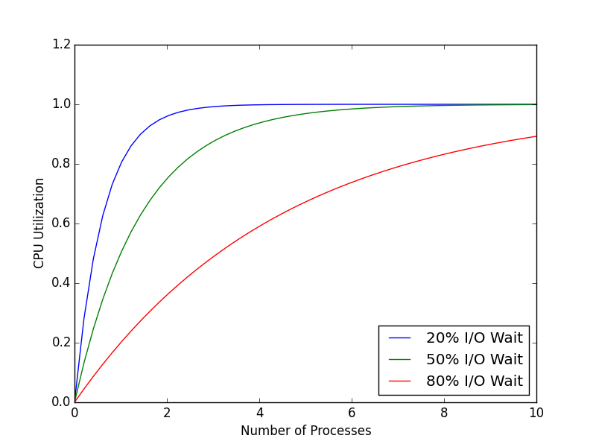
Notes:
We can start drawing nice little graphs like this.
The more we are I/O waiting the less we use the CPU

Slide 61
Utilization and Power
But – maximizing CPU usage may not be desirable!
Nowadays almost everyone uses laptops & mobile devices
These systems are energy-constrained, not CPU-constrained
Moore's law applies to CPUs, not batteries
So actually we may want to use the CPU as little as possible (while still letting users get work done)
Notes:
Turns out that this is no longer true
Because mobile
You desing it so that most programs are asleep all the time.
The newer mackbooks.

Slide 62
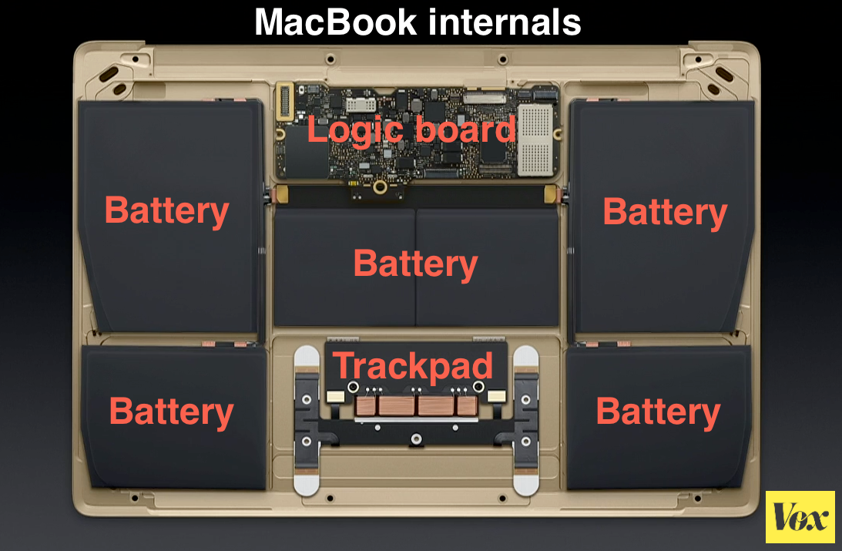
Notes:
The actual computer is the size of a smartphone. We have been able to make faster and better processors but Batterie still don’t hold that much energy.

Slide 63
Process Anatomy: Kernel
The kernel tracks what processes are active in a process table
Note: in most OSes, this is not a literal array, but rather something like a doubly-linked list
Each process gets a structure bit of metadata called the process control block (PCB)
Notes:
It might not only be a table. Could be a linked list, tree,
Process name, numeric id, the table of open file descriptors.
Task_struct
EPROCESS

Slide 64
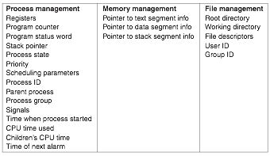
Process Control Block
Notes:
These are things that usually end up in a PCB

Slide 65
xv6 Process Table
struct {
struct spinlock lock;
struct proc proc[NPROC];
} ptable;
Notes:
It imposes a hard maximum NPROC = 64

Slide 66
Process Control Block in xv6
enum procstate { UNUSED, EMBRYO, SLEEPING, RUNNABLE, RUNNING, ZOMBIE };
// Per-process state
struct proc {
uint sz; // Size of process memory (bytes)
pde_t* pgdir; // Page table
char *kstack; // Bottom of kernel stack for this process
enum procstate state; // Process state
int pid; // Process ID
struct proc *parent; // Parent process
struct trapframe *tf; // Trap frame for current syscall
struct context *context; // swtch() here to run process
void *chan; // If non-zero, sleeping on chan
int killed; // If non-zero, have been killed
struct file *ofile[NOFILE]; // Open files
struct inode *cwd; // Current directory
char name[16]; // Process name (debugging)
};
Notes:
Each entry in the table is a lot more complicated.
Varios states, adds: zombie, embryo, unused.
Sz – size of memory
Each process gets its own kernely stack
Process id
State
Pointer to parent
Context: encapsulates the CPU context, registers when you switch back/forth
Killed
Table of open files,
Current working directory.
*chan is related for a process to go to sleep and wait for some other thing happening.

Slide 67
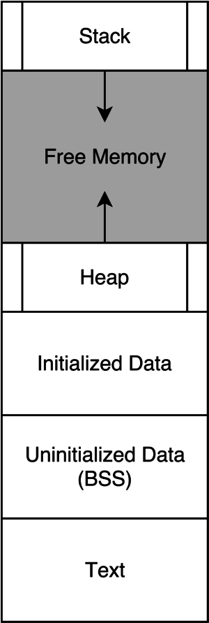
Process Anatomy: User Space
Text segment: actual program code
Data segment: program data
.data - initialized, read/write variables
.bss - uninitialized, read/write variables
.rodata - initialized, read-only variables (constants)
Stack
Heap - dynamic allocations
Notes:
Program code = text segment.
Heap = dynamically allocated memory.
Heap grows up
Typically there’s some check to make sure you haven’t grown out of memory less we kill that program.

Slide 68
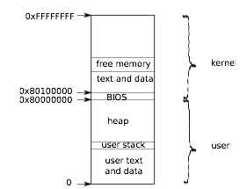
xv6 Address Space Layout
Notes:
More global view:
Upper half for the kernel.
Kernel also has code and data.
Can give some memory to the processes, by providing a mapping to that physical memory.

Slide 69
Scheduling
To coordinate the running of multiple processes, the OS includes a scheduling algorithm that decides what process will be run when, and for how long
There are tons of different scheduling algorithms with different goals:
Maximize CPU utilization
Maximize I/O throughput
Make the system feel responsive to the user
Meet real-time deadlines
Notes:
In the linux kernel they have gone through like a dozen different shcedulers.
Typically scheduling algorithms have ways to shceule

Slide 70
Other Scheduling Considerations
May want different process priorities
May want to handle I/O bound vs CPU-bound processes differently
May want to ensure fairness – make sure each process gets time to run
Notes:
So your matrix factorization program won’t be shceduled the same way a

Slide 71
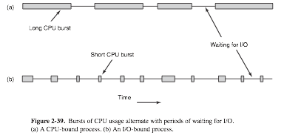
Notes:
This is an example of different kinds of processes.
You might do lots of computations and then do I/O, lots of computations little, I/) and so on.
Whereas another one might be way to different
I/O bound processes use very little of the CPU

Slide 72
When to Schedule
At timed intervals
We can use the hardware timer interrupt for this
When a process exits
No process is running now so we must choose one
When a process blocks on I/O
When an interrupt happens
May signal that I/O is done, and we want to unblock the relevant process
Notes:
We are a scheduler we decide when the processes get scheduled.
You have your timer which is just a Quartz crystal which gives you an interrupt.
You can say whenever I get this hardware interrupt, I switch processes.
Also when a process exits
Also When a process requests some I/O
Whenever that counter finishes
Network packet.

Slide 73
Preemption
Schedulers can be further classified by whether or not processes can choose when they stop running
Non-Preemptive schedulers let processes run until they block on I/O or yield voluntarily
Preemptive schedulers take advantage of a timer interrupt
Notes:
So whether they let programs run for as long as they want or whether they preemp them.
If you have a non preemtive shceduler you let them run until they block or yield.
Non preemptive schedulers can be nice, because the program can decide how long it needs the CPU,
But there are problems because badly behaved processes can hog the CPU, or ones with bugs, etc.
These days most OSs are preemptive, I think

Slide 74
Round Robin Scheduling
A simple, preemptive scheduling algorithm
Run first process until its quantum is used up
Move that process to the end and run the next process until its quantum is used up
Simple, fair
Notes:
One of the simplest ones is called
Round Robin
It’s basically a list of processes everyone gets a quantum, say 10ms to run and when it’s done, gets put to the end of the queue
The next process gets run for another 10ms until it’s quantum is used up and so on.
This is very simple and fair.

Slide 75
xv6 Scheduler
xv6 uses round robin
Whenever scheduling happens, loop over the array until we find a runnable process and switch to it
When the timer runs or the process yields, we return to the scheduler loop
Importantly, we return to the loop at the exact place we left off – this is what makes it fair and ensures we don't starve processes later in the list
Notes:
So it won’t surprise you that our simple OS uses round robin of processes that we saw before.

Slide 76
Proc.c
void
scheduler(void)
{
struct proc *p;
for(;;){
// Enable interrupts on this processor.
sti();
// Loop over process table looking for process to run.
acquire(&ptable.lock);
for(p = ptable.proc; p < &ptable.proc[NPROC]; p++){
if(p->state != RUNNABLE)
continue;
// Switch to chosen process. It is the process's job
// to release ptable.lock and then reacquire it
// before jumping back to us.
proc = p;
switchuvm(p);
p->state = RUNNING;
swtch(&cpu->scheduler, proc->context);
switchkvm();
// Process is done running for now.
// It should have changed its p->state before coming back.
proc = 0;
}
release(&ptable.lock);
}
}
Notes:
Uses the swtch to switch the context between the kernel in the scheduler and the process itselft.
It basically saves where it was on the loop.
So let’s look in more detail on the magic here

Slide 77
Context Switching
The actual scheduler context switch (to start executing the process) happens here:
Let's examine these in more detail
// Switch to chosen process. It is the process's job
// to release ptable.lock and then reacquire it
// before jumping back to us.
proc = p;
switchuvm(p);
p->state = RUNNING;
swtch(&cpu->scheduler, proc->context);
switchkvm();

Slide 78
switchuvm
This function does two things:
Switches the task state segment to the user-mode one
Changes the current virtual address space to the process's
Notes:
We will see that the task state segment is in a sec.

Slide 79
Task State Segment (TSS)
The TSS is a special structure defined by x86 intended to help with context switching
However, hardware context switching is slow, so most OSes make minimal use of the TSS (software context switching)
Some parts are still necessary though:
Location of kernel stack for this process
Segment descriptor for kernel stack
It is possible to have multiple TSS (e.g. one for each process), but in practice a single one is used for all processes
Notes:
At some point intel added this feature to help OS authors to write the context switching code
Turns out it was slower than writing it in Software.

Slide 80
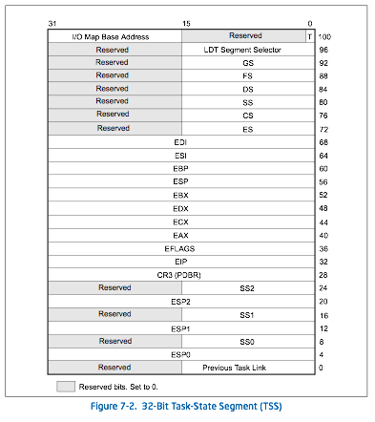
Notes:
Data structure that you have to define for this task switch stuff.

Slide 81
switchuvm
// Switch TSS and h/w page table to correspond to process p.
void
switchuvm(struct proc *p)
{
pushcli();
cpu->gdt[SEG_TSS] = SEG16(STS_T32A, &cpu->ts, sizeof(cpu->ts)-1, 0);
cpu->gdt[SEG_TSS].s = 0;
cpu->ts.ss0 = SEG_KDATA << 3;
cpu->ts.esp0 = (uint)proc->kstack + KSTACKSIZE;
ltr(SEG_TSS << 3);
if(p->pgdir == 0)
panic("switchuvm: no pgdir");
lcr3(v2p(p->pgdir)); // switch to new address space
popcli();
}
Notes:
We switch that Task Sate Segment.

Slide 82
void
scheduler(void)
{
struct proc *p;
for(;;){
// Enable interrupts on this processor.
sti();
// Loop over process table looking for process to run.
acquire(&ptable.lock);
for(p = ptable.proc; p < &ptable.proc[NPROC]; p++){
if(p->state != RUNNABLE)
continue;
// Switch to chosen process. It is the process's job
// to release ptable.lock and then reacquire it
// before jumping back to us.
proc = p;
switchuvm(p);
p->state = RUNNING;
swtch(&cpu->scheduler, proc->context);
switchkvm();
// Process is done running for now.
// It should have changed its p->state before coming back.
proc = 0;
}
release(&ptable.lock);
}
}

Slide 83
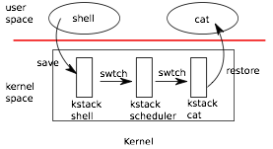
swtch
Notes:
This is how this looks pictorially.
We are in the user space
Our quantum expires
We save our state,
Switch to kernel space
Go through the scheduling table
The scheduler finds another process
Switch to another process.

Slide 84
swtch
Does the actual work of switching between the kernel scheduler context and the kernel process context
Only needs to save a few registers:
struct context {
uint edi;
uint esi;
uint ebx;
uint ebp;
uint eip;
};
Notes:
Conceptually it’s very simple
Just saves a few registers
What about the others ones?
Where is eax?

Slide 85
What About the Others?
Don't need to save segment registers because those are the same for all kernel contexts
Don't need to save eax, ecx, edx – in the gcc calling convention, these are not assumed to persist across function calls
So any code that calls swtch() will automatically preserve them
Notes:
The calling function will automatically save them.
When you make a call it saves the PC because needed.
Because of this combination of how call instructions work and how calliing conventions works, you end up just having to save 5 registers.

Slide 86
# Context switch
#
# void swtch(struct context **old, struct context *new);
#
# Save current register context in old
# and then load register context from new.
.globl swtch
swtch:
movl 4(%esp), %eax
movl 8(%esp), %edx
# Save old callee-save registers
pushl %ebp
pushl %ebx
pushl %esi
pushl %edi
# Switch stacks
movl %esp, (%eax)
movl %edx, %esp
# Load new callee-save registers
popl %edi
popl %esi
popl %ebx
popl %ebp
ret
Notes:
The first little bit just saves the parameters
When you do the ret you should come back to the program you are swtiching to.

Slide 87
# Context switch
#
# void swtch(struct context **old, struct context *new);
#
# Save current register context in old
# and then load register context from new.
.globl swtch
swtch:
movl 4(%esp), %eax
movl 8(%esp), %edx
# Save old callee-save registers
pushl %ebp
pushl %ebx
pushl %esi
pushl %edi
# Switch stacks
movl %esp, (%eax)
movl %edx, %esp
# Load new callee-save registers
popl %edi
popl %esi
popl %ebx
popl %ebp
ret
struct context {
uint edi;
uint esi;
uint ebx;
uint ebp;
uint eip;
};
Notes:
This lines up very nicely with this context data structure.

Slide 88
# Context switch
#
# void swtch(struct context **old, struct context *new);
#
# Save current register context in old
# and then load register context from new.
.globl swtch
swtch:
movl 4(%esp), %eax
movl 8(%esp), %edx
# Save old callee-save registers
pushl %ebp
pushl %ebx
pushl %esi
pushl %edi
# Switch stacks
movl %esp, (%eax)
movl %edx, %esp
# Load new callee-save registers
popl %edi
popl %esi
popl %ebx
popl %ebp
ret
Note: EIP is implicitly saved by executing the call – call pushes the EIP of the next instruction onto the stack
struct context {
uint edi;
uint esi;
uint ebx;
uint ebp;
uint eip;
};
Notes:
The program Counter => EIP is implicitly being saved when you do the

Slide 89
swtch-ing Back
When a process gives up the CPU, yield() is called
yield() makes the process runnable and then calls sched()
Note: not the same as scheduler()
// Give up the CPU for one scheduling round.
void
yield(void)
{
acquire(&ptable.lock); //DOC: yieldlock
proc->state = RUNNABLE;
sched();
release(&ptable.lock);
}
Notes:
Finally at some point we want to switch back.
Your process could call yield.

Slide 90
sched()
// Enter scheduler. Must hold only ptable.lock
// and have changed proc->state.
void
sched(void)
{
int intena;
if(!holding(&ptable.lock))
panic("sched ptable.lock");
if(cpu->ncli != 1)
panic("sched locks");
if(proc->state == RUNNING)
panic("sched running");
if(readeflags()&FL_IF)
panic("sched interruptible");
intena = cpu->intena;
swtch(&proc->context, cpu->scheduler);
cpu->intena = intena;
}
Notes:
Here it just checks some things, then
Switches the context back into the scheduler context

Slide 91
sched()
// Enter scheduler. Must hold only ptable.lock
// and have changed proc->state.
void
sched(void)
{
int intena;
if(!holding(&ptable.lock))
panic("sched ptable.lock");
if(cpu->ncli != 1)
panic("sched locks");
if(proc->state == RUNNING)
panic("sched running");
if(readeflags()&FL_IF)
panic("sched interruptible");
intena = cpu->intena;
swtch(&proc->context, cpu->scheduler);
cpu->intena = intena;
}
Where does this go?
Notes:
Swtch takes us into the CPU scheduler

Slide 92
void
scheduler(void)
{
struct proc *p;
for(;;){
// Enable interrupts on this processor.
sti();
// Loop over process table looking for process to run.
acquire(&ptable.lock);
for(p = ptable.proc; p < &ptable.proc[NPROC]; p++){
if(p->state != RUNNABLE)
continue;
// Switch to chosen process. It is the process's job
// to release ptable.lock and then reacquire it
// before jumping back to us.
proc = p;
switchuvm(p);
p->state = RUNNING;
swtch(&cpu->scheduler, proc->context);
switchkvm();
// Process is done running for now.
// It should have changed its p->state before coming back.
proc = 0;
}
release(&ptable.lock);
}
}
Here
Notes:
The last place we called switch which is right here.
At this point we erload the kernel address space.
This mechanism is very cool because it could let you implement threading.

